Slide 1

Practical Data Science with Python Assignment 2
Peter Leslie Moorhead s3602584

Slide 2
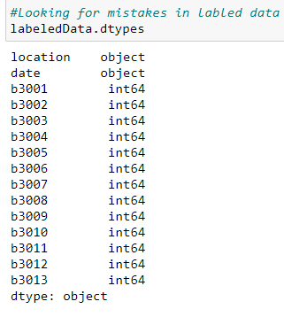
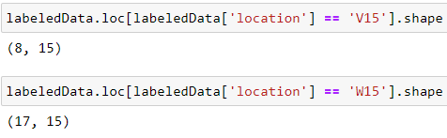
BLE RSSI Dataset for Indoor localization and Navigation Data Set
Import Errors
Data types
Typos
Whitespace
Case
Impossible values

Slide 3
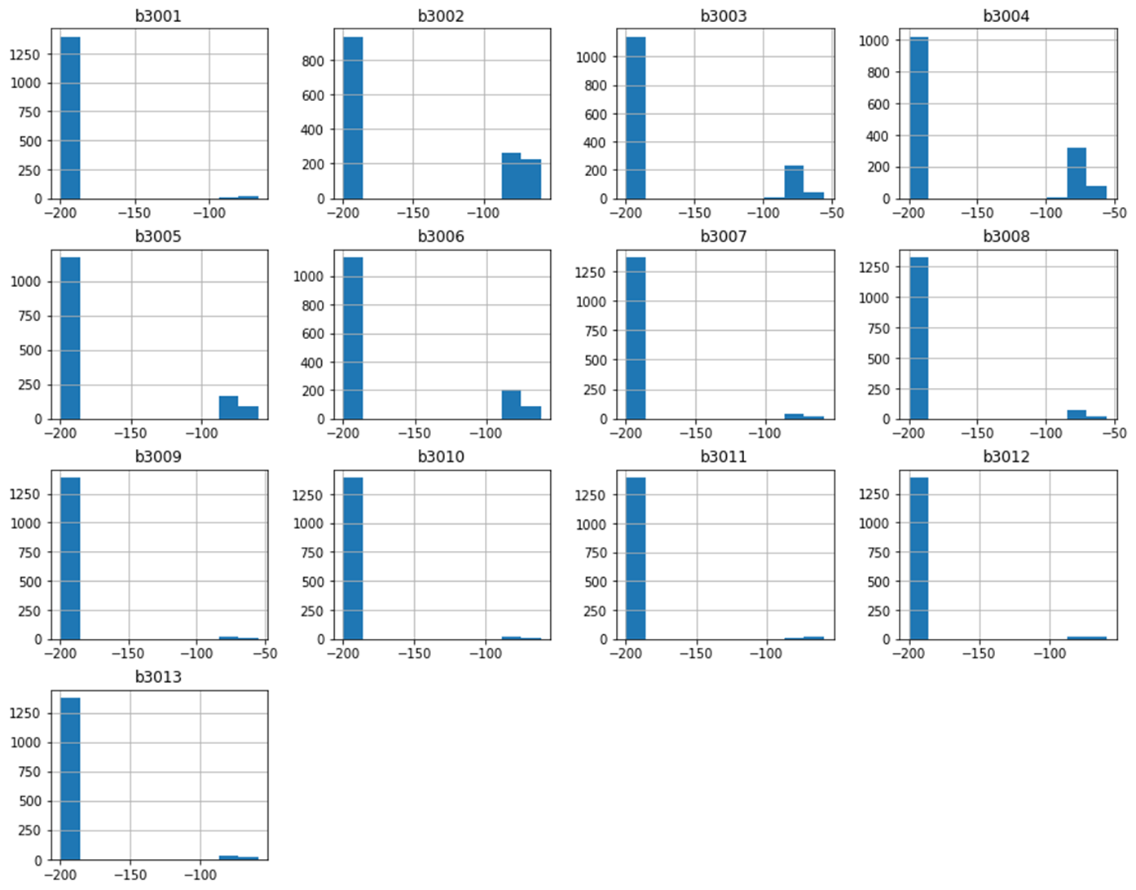
Hypotheses
Entrance
Geographic Location
Beacon relationships
Interesting negative relationships
Possible Interference
Starting beacon survey

Slide 4
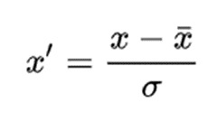
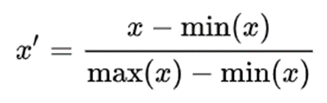
Modelling
Standard Scaling
Scaling
Training \Testing Split
Feature selection
Feature Hypertuning
Cross validation
K Nearest Neighbour
Decision Tree
Min Max Scaling

Slide 5
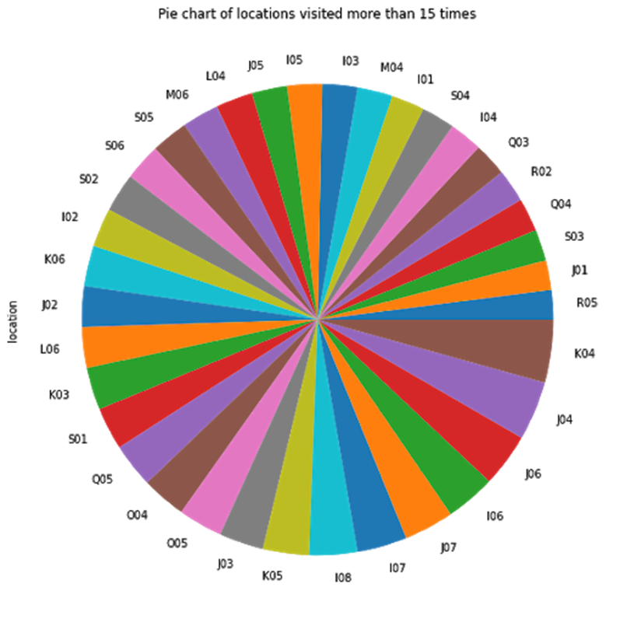
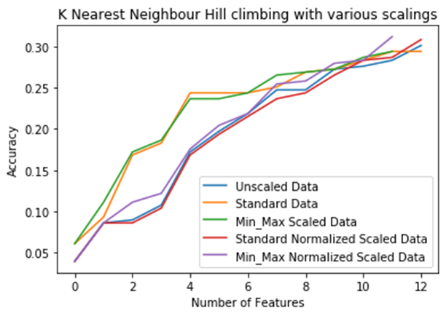
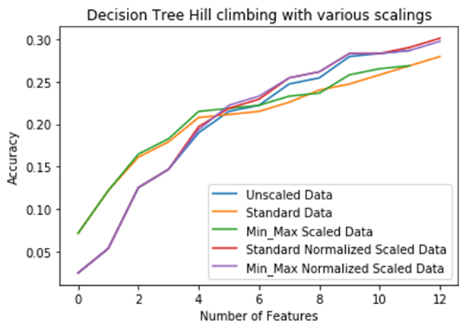
Results
Different combination results
KNN
DT

Slide 6
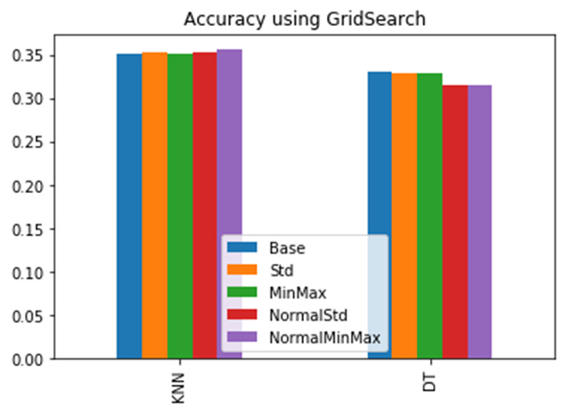
Conclusion and Recommendation
Currently not accurate enough to be useful
Min Max Scaling
GridSearch
KNN
Navigation

